Slide 1


DESIGN 1
Lesson 2: Guided Practice: Building a Navigation Menu
Ms. Abboud • Grade 9 - Design 1 • Term 1, Week 5

Slide 2
Learning Objectives
WALT - We Are Learning To
WILF - What I'm Looking For
Build a working navigation menu that links multiple pages, with support.
Spot and fix broken relative links.
My navigation menu links to at least 2 real pages.
All links work correctly when clicked in the browser.

Slide 3
Academic Vocabulary
Navigation
The system of links (often a menu) that lets a visitor move between the different pages of a website.

Slide 4
Frayer Model: Navigation
DEFINITION
CHARACTERISTICS
The system of links (often a menu) that lets a visitor move between the different pages of a website.
Usually a list of links; appears on every page; helps users move around.
NAVIGATION
EXAMPLES
NON-EXAMPLES
A menu bar with Home/About/Contact.
A single link buried in a paragraph.

Slide 5
National Identity Integration
UAE Government Digital Services: clear, consistent menus on government websites help every resident find the service they need quickly, whichever page they land on first.

Slide 6
STARTER
Quick Recap
What tag and attribute make a hyperlink?
Write the full code for a link to about.html.
Hook • Engage & Ask
5 - 10 minutes

Slide 7
LESSON CORE
I Do: Lists + Links = Navigation
Watch: last week's <ul> list, with an <a> link inside each <li>.
Wrap it in <nav> and place it at the top of every page.
Gradual Release of Responsibility
30 - 40 minutes
Example: a navigation menu
<nav>
<ul>
<li><a href="index.html">Home</a></li>
<li><a href="about.html">About</a></li>
<li><a href="contact.html">Contact</a></li>
</ul>
</nav>
1 / 3

Slide 8
LESSON CORE
We Do: Checkpoint by Checkpoint
Checkpoint 1: create about.html and contact.html.
Checkpoint 2: build the <nav> menu with a link to each page.
Common error check: wrong filename, wrong capital letters, missing .html.
Gradual Release of Responsibility
30 - 40 minutes
2 / 3

Slide 9
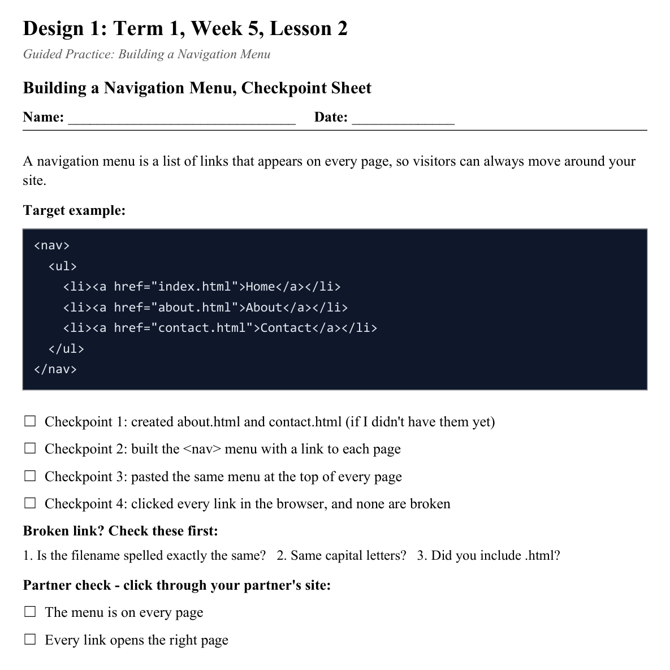
LESSON CORE
You Do: Build & Test
Add the menu to the top of at least 2 pages, then click every link in the browser.
Track your progress on the Checkpoint Sheet.
Activity: Building a Navigation Menu, Checkpoint Sheet
Gradual Release of Responsibility
30 - 40 minutes
3 / 3

Slide 10
CLOSURE
Partner Demo
Click through your navigation menu for a partner, with no broken links.
Transition & Extend
5 - 10 minutes

